Slide 1
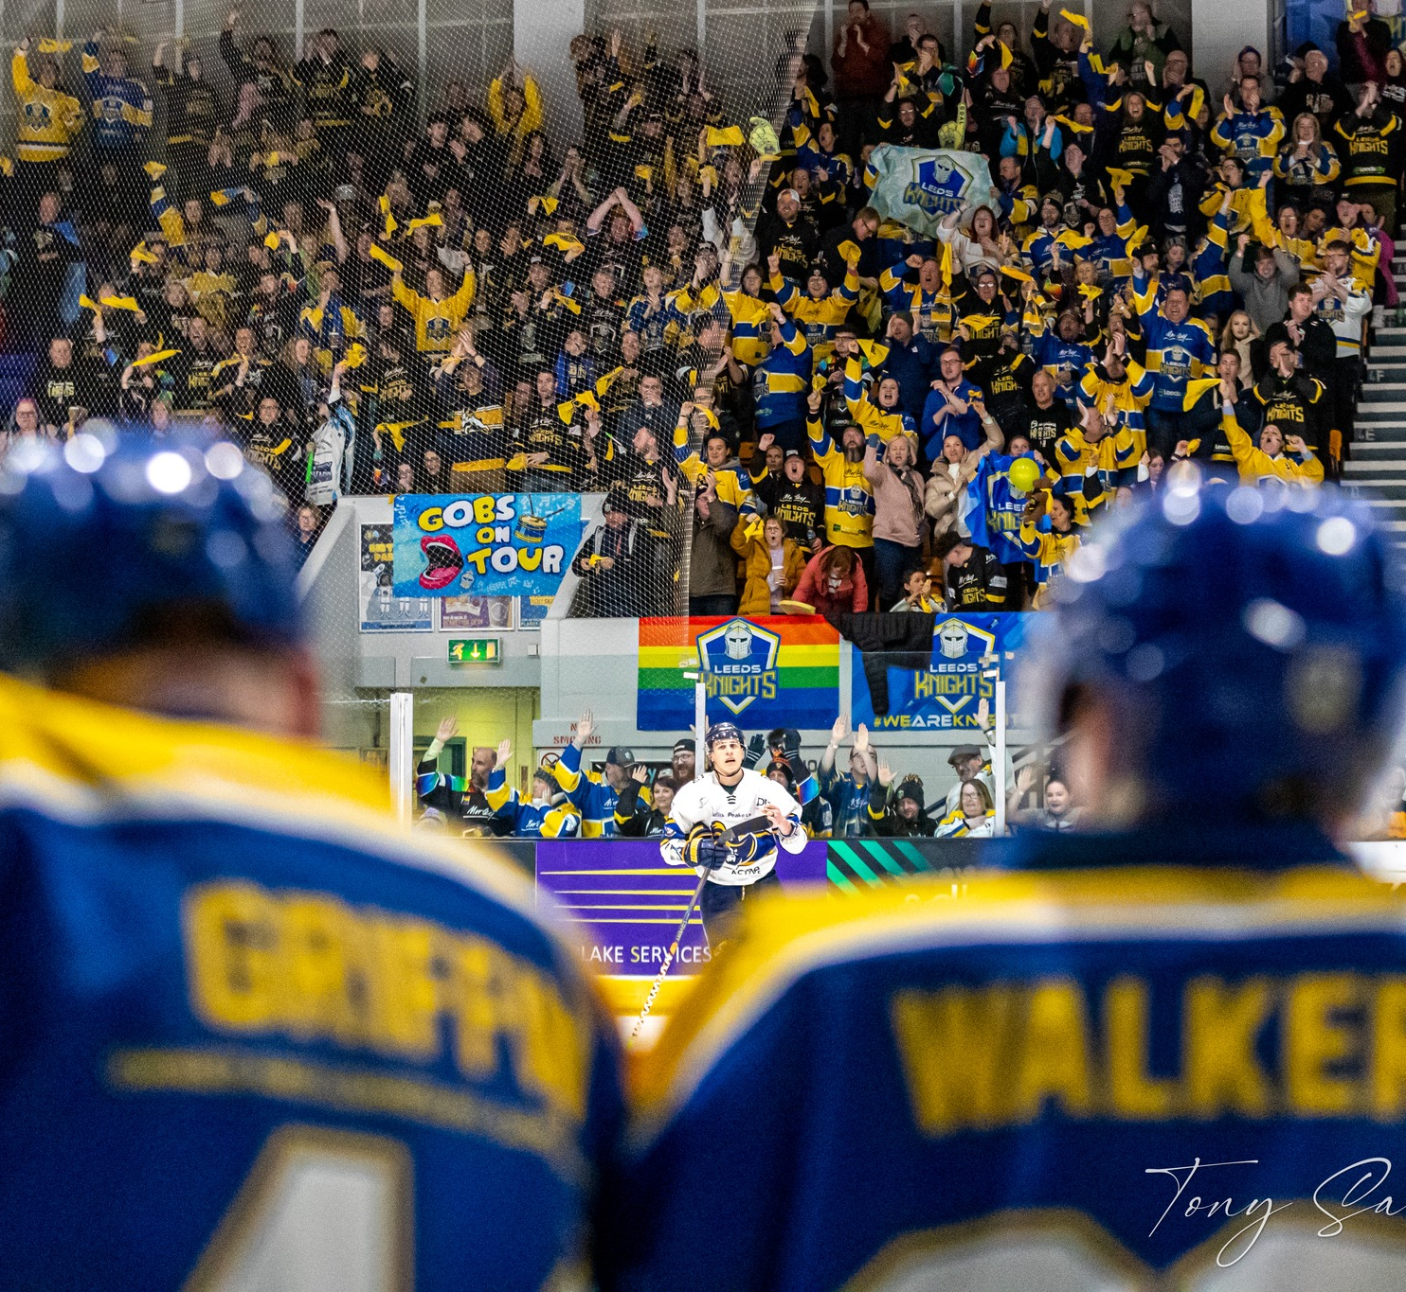
Club toolkit and development plan
March 2024
englandicehockey.com

Slide 2
Starting a club

Slide 3
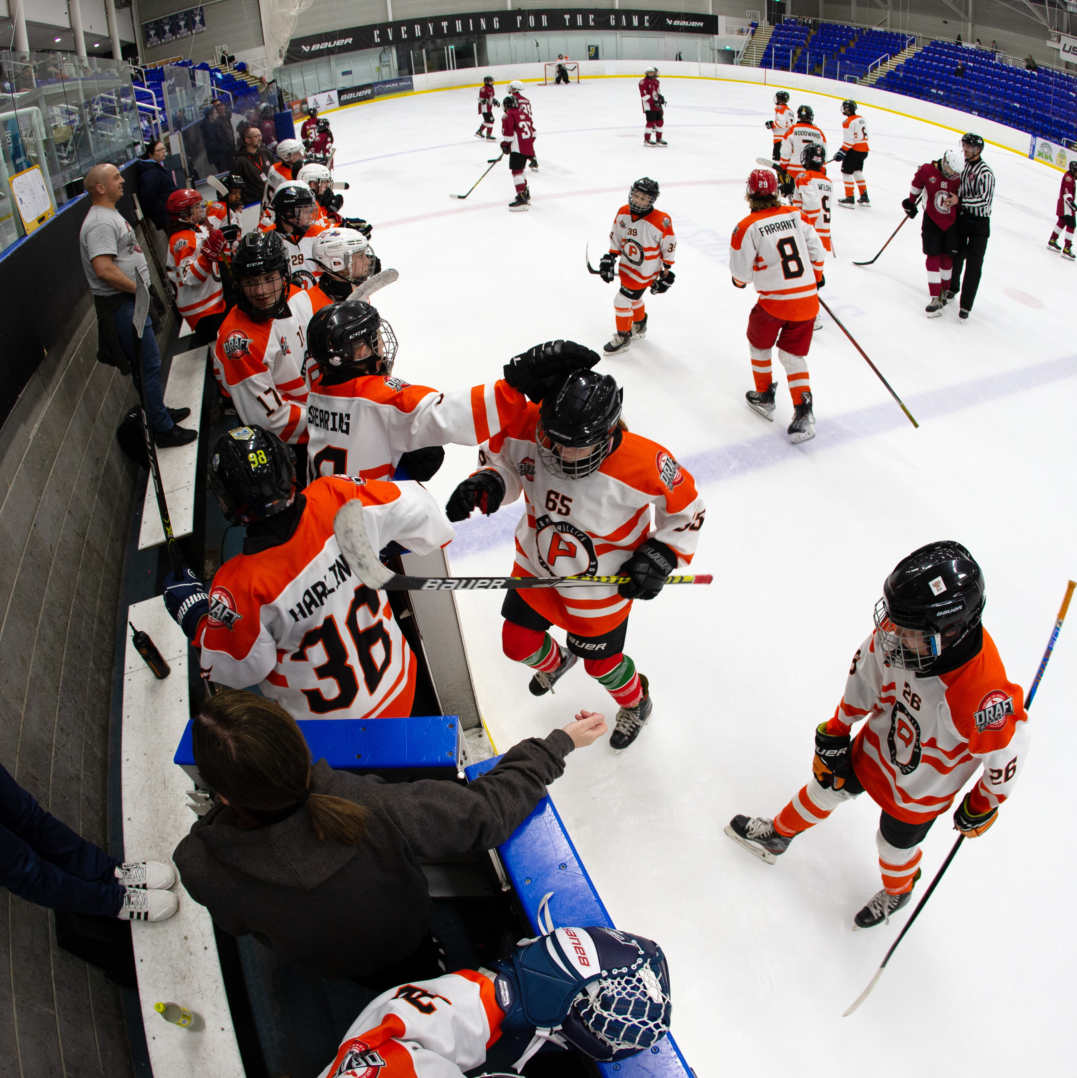
Affiliation
The first stage of starting a new club is gaining acceptance from England Ice Hockey to affiliate.
Affiliation is free of charge and clubs and teams need to renew their affiliation each year to maintain membership. Benefits of affiliating with England Ice Hockey include:
Combined Liability Insurance
Access to compete in England Ice Hockey leagues and competitions
Access for members to England Ice Hockey development and coaching and education pathways
Dedicated club support
Access to a wealth of resources for clubs
Access to apply to host and attend tournaments and hockey camps
Enforcement of the England Ice Hockey Code of Conduct & Ethics and Discipline Procedure
Please read the checklist on the following pages and contact info@englandicehockey.com to begin your affiliation with us.

Slide 4
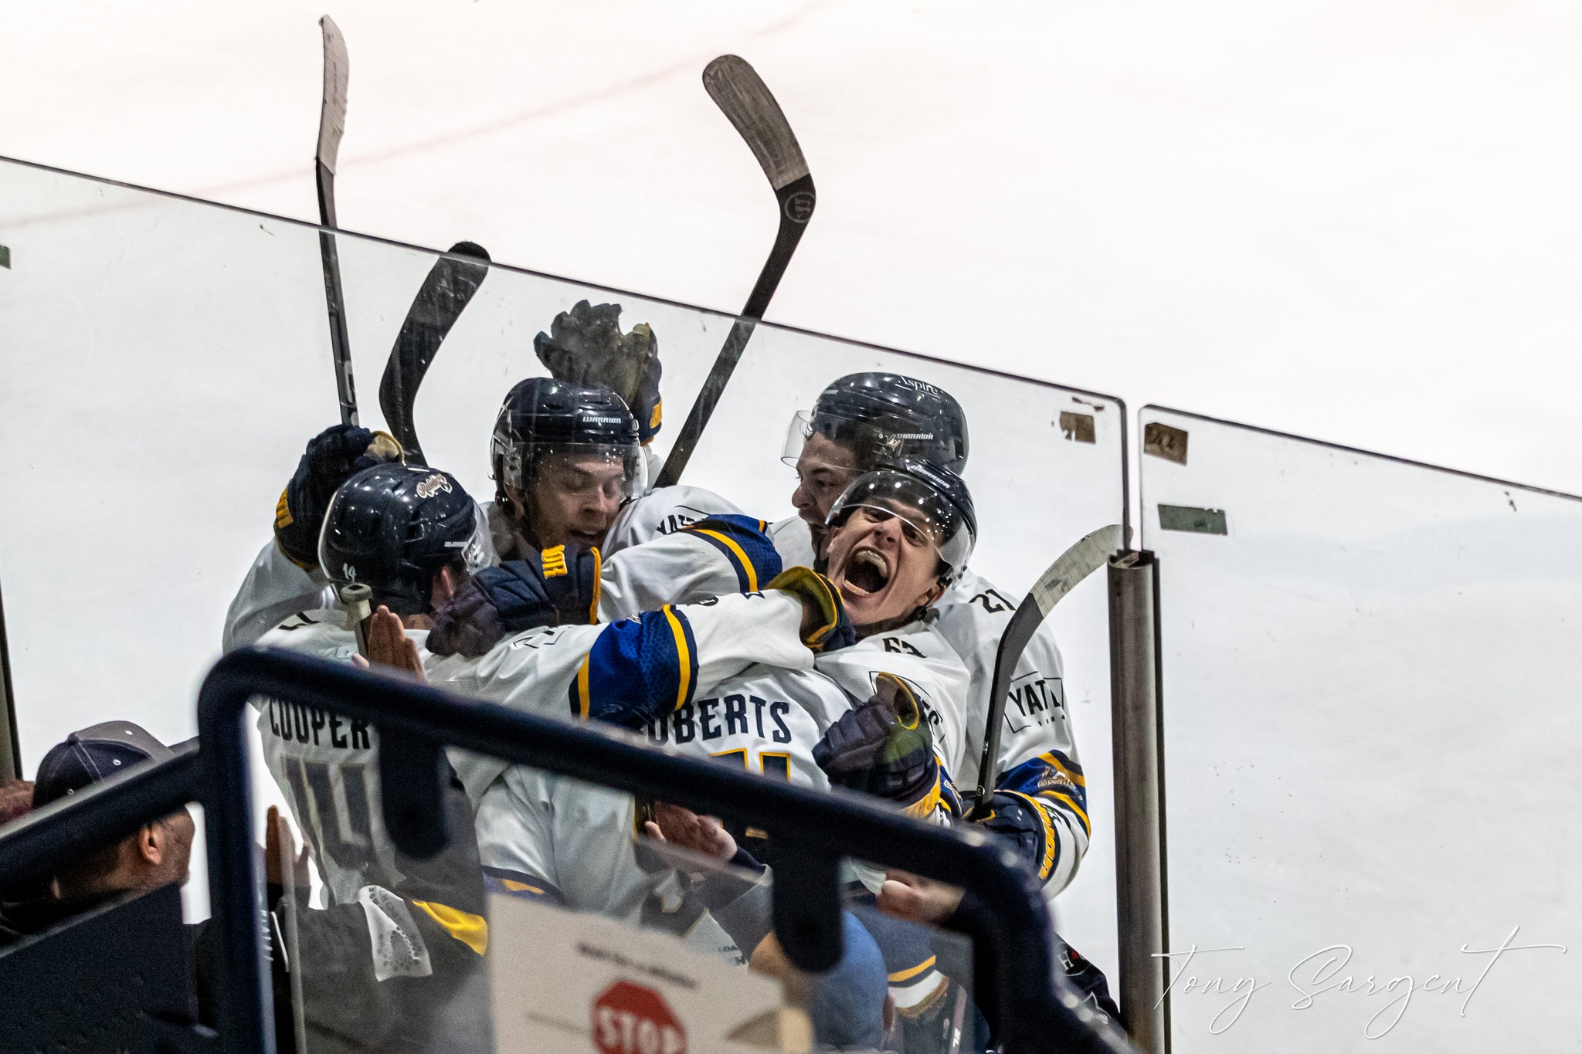
Affiliation checklist (part 1)
Recognised as any of the following:
  Recognised by England Ice Hockey as entering an England Ice Hockey sanctioned league or competition (or approved as training only)
  Officially affiliated with a university sporting section (BUIHA only)
  Officially affiliated with the England Ice Hockey Recreational section
Have a club committee consisting of a Chairperson, Secretary and Treasurer
Have a Head Coach who is an England Ice Hockey licenced Level 2 Team Coach
Have a Designated Safeguarding Lead if there are players aged under 18
Have a bank account with appropriate signatories
Have a suitable venue for playing ice hockey which appears on the England Ice Hockey approved venue list
Ensure your Club members are also registered as England Ice Hockey members. Clubs must submit an initial membership database of a minimum of 14 persons.
Acknowledge and adhere to England Ice Hockey policies

Slide 5
Affiliation checklist (part 2)
Clubs must also:
Publish its legal name, form (e.g. unincorporated association, company limited by shares or guarantee etc) and any identifier (e.g. company number). In addition, for those clubs that are owned, the club shall also publish the identities of the owner.
Submit a digital copy of the club/team logo, to be approved by England Ice Hockey
Submit a digital copy of the team strip, to be approved by England Ice Hockey
Submit a copy of the public liability insurance from the club’s ice rink
Be committed to maintain and develop the spirit of the game
Be able to provide an ice time contract demonstrating they are able to fulfil their fixture responsibilities.
Promote England Ice Hockey at all times
Any club affiliating with England Ice Hockey (EIH) acknowledges that, in the event of EIH insolvency, they can be called upon to guarantee the debts of the association to the sum of £50.00 (Fifty Pounds).

Slide 6
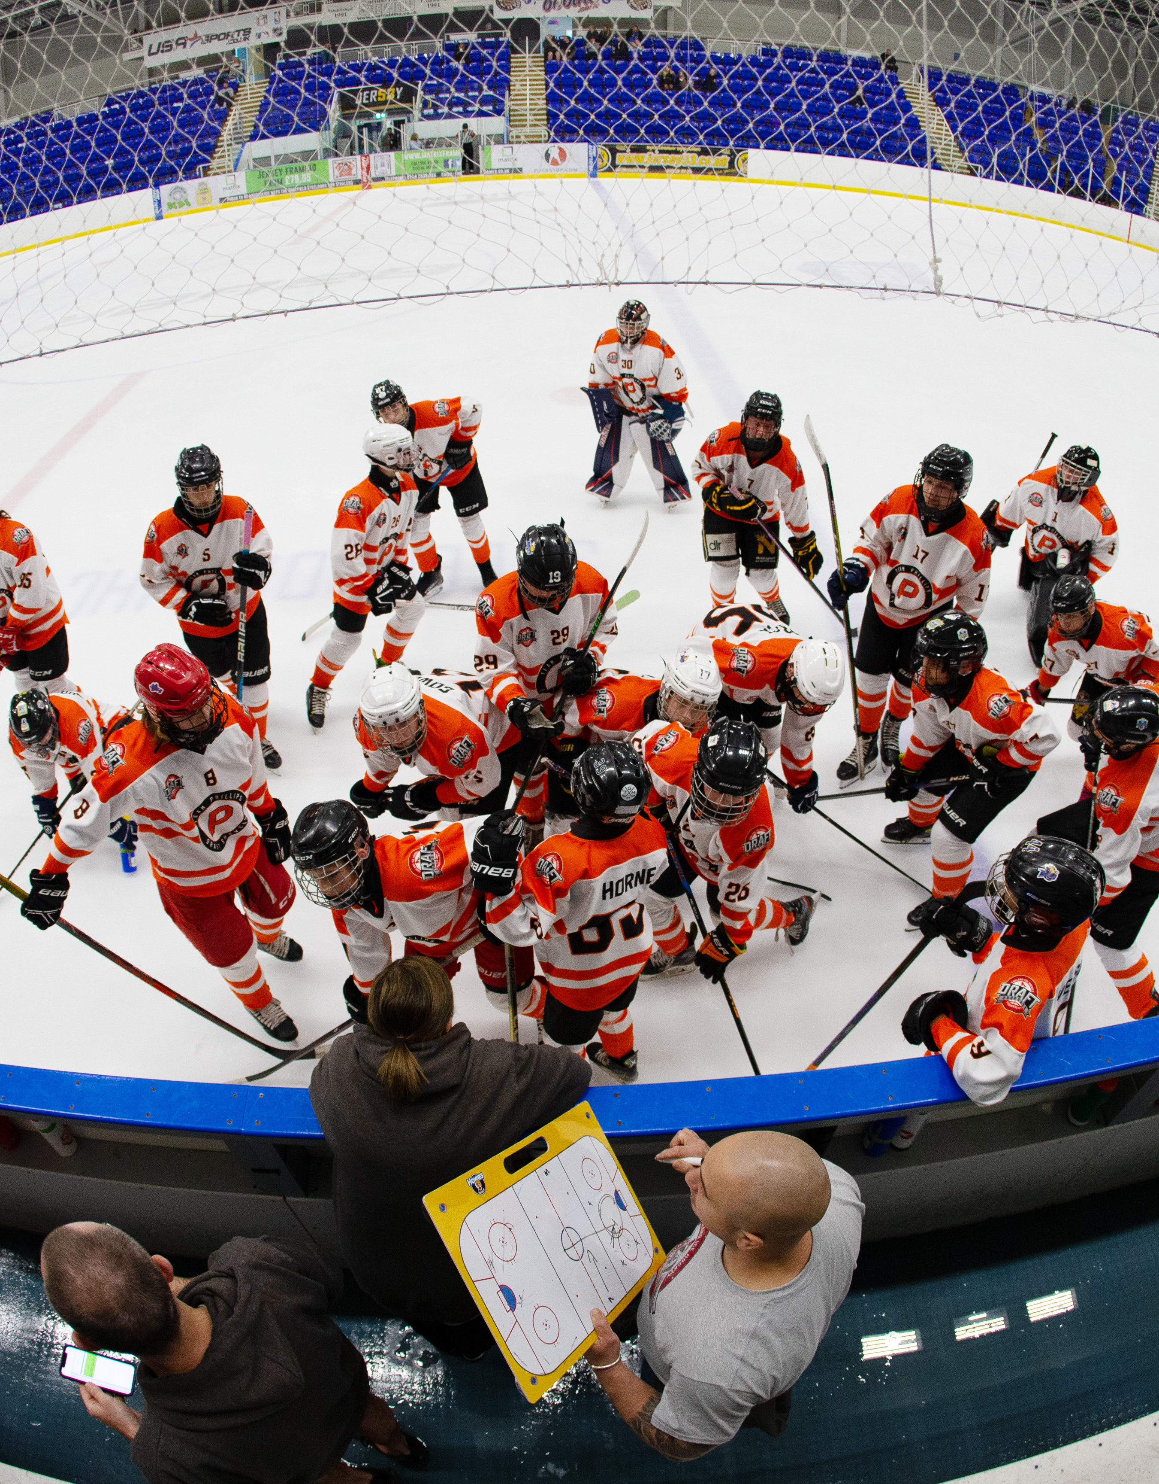
The importance of good governance
Having a strong committee with robust policies and procedures is crucial for good governance.
It helps to implement robust and reliable systems, processes, and policies.
It creates an open and transparent decision making and reporting processes.
It ensures clubs can make decisions about their activity and future more effectively.
It increases the professionalism of the club and sport, crucial for gaining funding and sponsors.
Holding an AGM helps ensure you take decisions which are inclusive and enable individuals from different backgrounds to contribute fully.

Slide 7
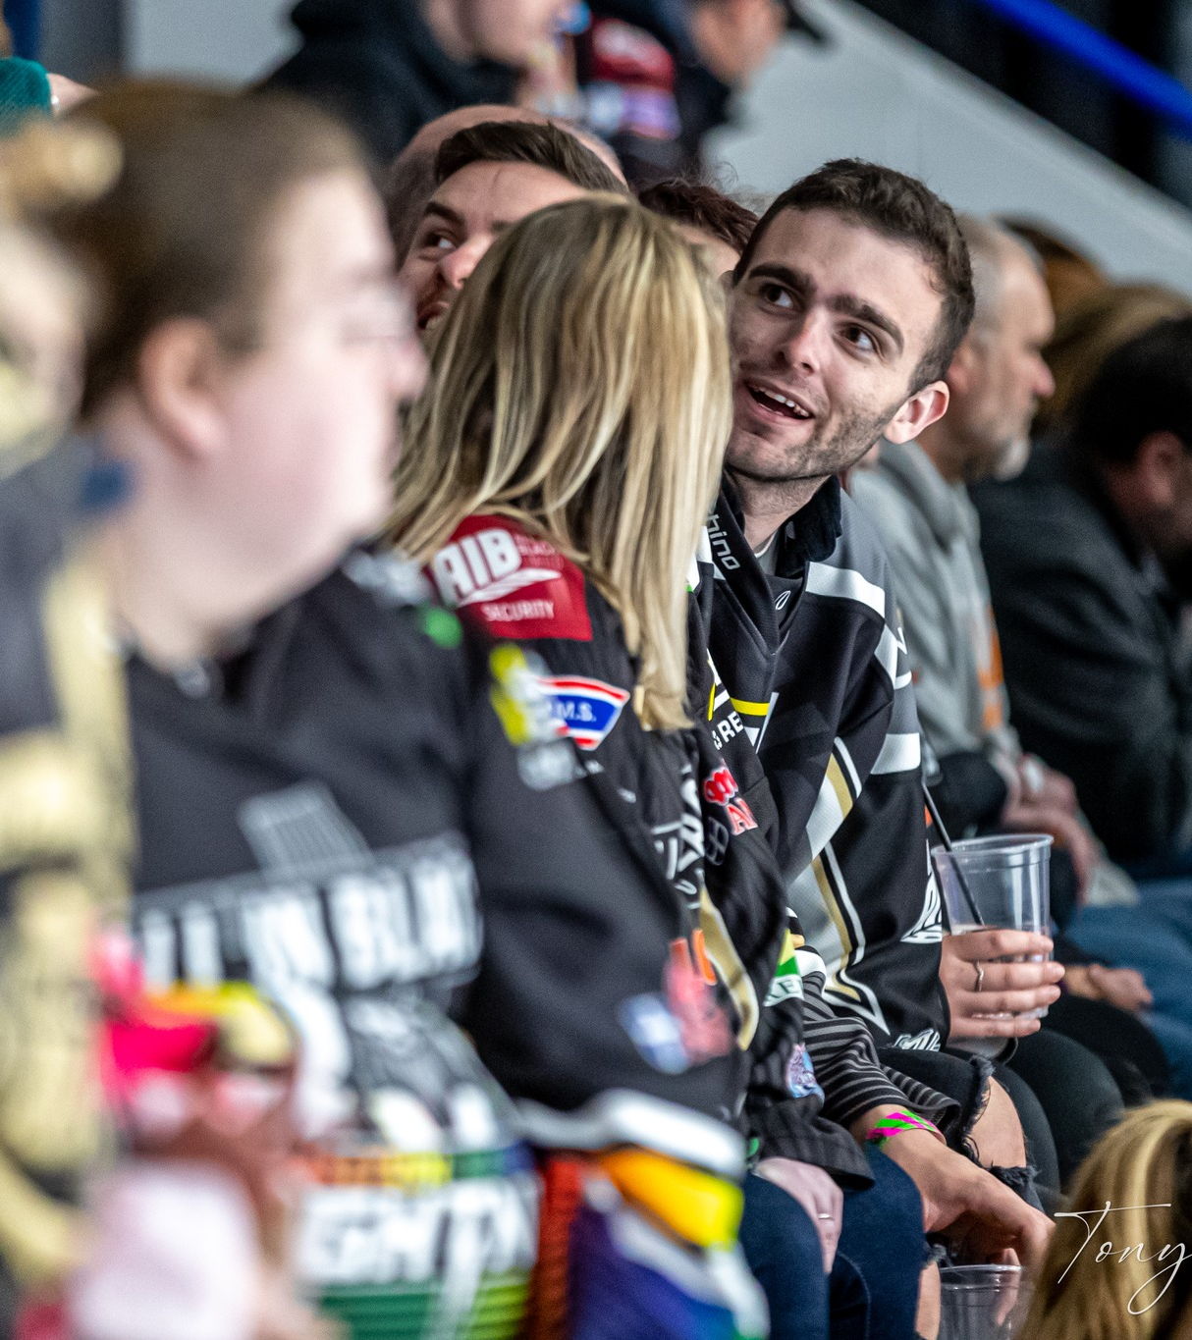
Good governance checklist
The following policies will help you to implement strong governance at your club. Our website has several templates you can use and adapt to help.
Club constitution
Committee role descriptions
Code of conduct for players, coaches, volunteers and parents
Safeguarding policy
Risk assessment
Medical emergency action plan
Health and safety policy
Privacy policy
Membership terms and conditions (recommended)
Equality, diversity and inclusion statement / policy (recommended)
Accident and incident reporting form
Club volunteer agreement
Communications plan

Slide 8
Insurance
Insurance is a key element of running a club, required to protect the club and its players.
All affiliated clubs and individuals registered with England Ice Hockey benefit from England Ice Hockey’s combined liability insurance policy which includes:
£10 million public liability cover
Personal accident cover for individuals registered with England Ice Hockey when taking part in sanctioned activities
Coverage runs until 31 July.
Clubs are required to purchase their own travel insurance for international travel. Clearance from England Ice Hockey and IHUK is required for travel.
Clubs are also required to provide, on request, a copy of their rink’s public liability insurance. Individual coaches and practitioners may also get their own professional insurance to cover them should they wish.
Employer's liability is also recommended if your club employs staff whether on a paid or voluntary basis.

Slide 9
Club development plan

Slide 10
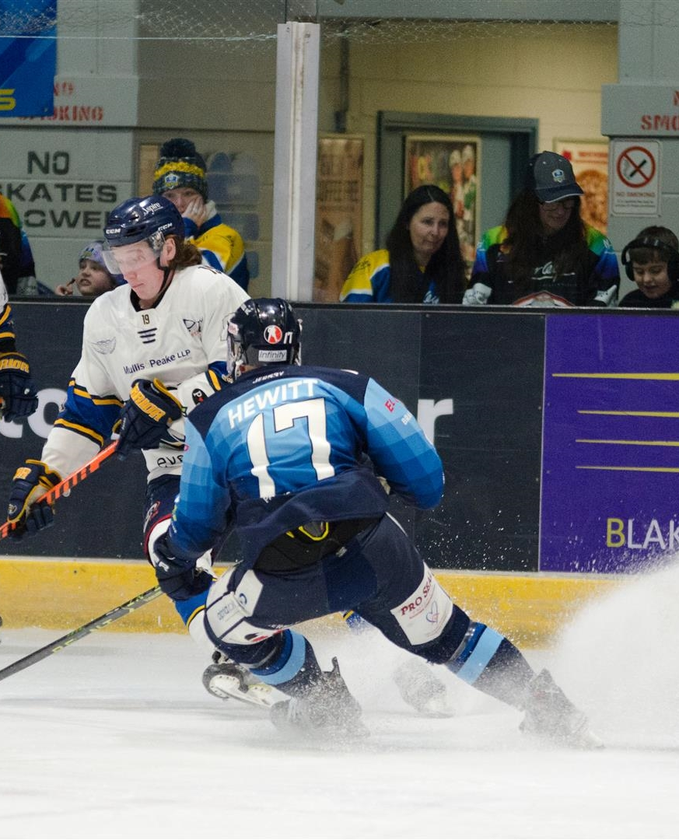
Introduction
A club development plan is a must for every club. The plan should be written by your club’s committee and state the club’s vision for a period of time e.g. annual, three years.
The plan can be a working document to demonstrate the changing environment within a club but should state the club’s aims and how they will go about achieving them.
New clubs are advised to keep such plans clear and concise and avoid unnecessary jargon.
Club Development Plans should be designed to answer key questions:
Why do we exist?
Where are we now?
Where do we want to be?
How are we going to get there?
Make sure your goals are SMART (specific, measurable, achievable, realistic, timescales).
The table in our club development template will help you establish this.

Slide 11
Current position
You need a clear idea of where the club is now, in order to effectively plan development and assess progress.
By carrying out a SWOT analysis (Strengths, Weaknesses, Opportunities and Threats), you will be able to identify the strong points within your club, areas that require work on, potential opportunities that may benefit your club, and threats that may affect the club.
Clubs change in size and structure frequently, but it’s important to be able to scale effectively to support growth in a sustainable way.
Possible questions that need to be answered at this stage are as follows.

Slide 12
Members
Activities
How many new participants do you (need to) recruit each year?
How many do you retain?
Do you have non-playing memberships?
What’s the cost of participating at your club?
How does your membership compare with others in the local area?
Do you utilise members’ skills through them being volunteers?
What’s your ethos?
What activities / age groups do you offer?
What do you not offer?
How successful have you been in competitions?
Which activities are the most popular?
How many training sessions do you run weekly?
How do you support and reward volunteers?
How do you communicate with members and is this effective?
Coaches / Volunteers
Wider club
How many coaches / volunteers do you have?
What qualifications do they hold?
What training have they done this year?
How many coaches or volunteers do you realistically and ideally need?
What policies do you have and are they still relevant?
What is your committee club structure and do you have role descriptions with clear responsibilities?
Do you elect committee members? How?
Does your club have a constitution?

Slide 13
Ice hockey key considerations
Top tips to help growth
Do you have sufficient ice time for competition to add additional age groups?
Do you have sufficient ice time for additional training sessions?
Do you have additional spaces you can utilise for off-ice training sessions?
Do you have enough L2 coaches to cover holidays and illness?
Ice hockey is expensive! Can you obtain funding or sponsorship to mitigate costs?
If your ice time is limited, can you set up a training only development team where players play challenge games?
To incorporate more training opportunities, consider running two age groups (half ice) at the same time. If you stagger the age groups e.g. U12 and U16 together, each age group could have the opportunity to train with a higher age group (if appropriate) in another slot, giving them more time on the ice.
Can you run off-ice sessions to complement your training?
Can you entice coaches by offering to pay for their qualifications? Succession planning is key.
There are lots of funds out there. Having the right governance and policies in place will put you in a great position to apply.

Slide 14
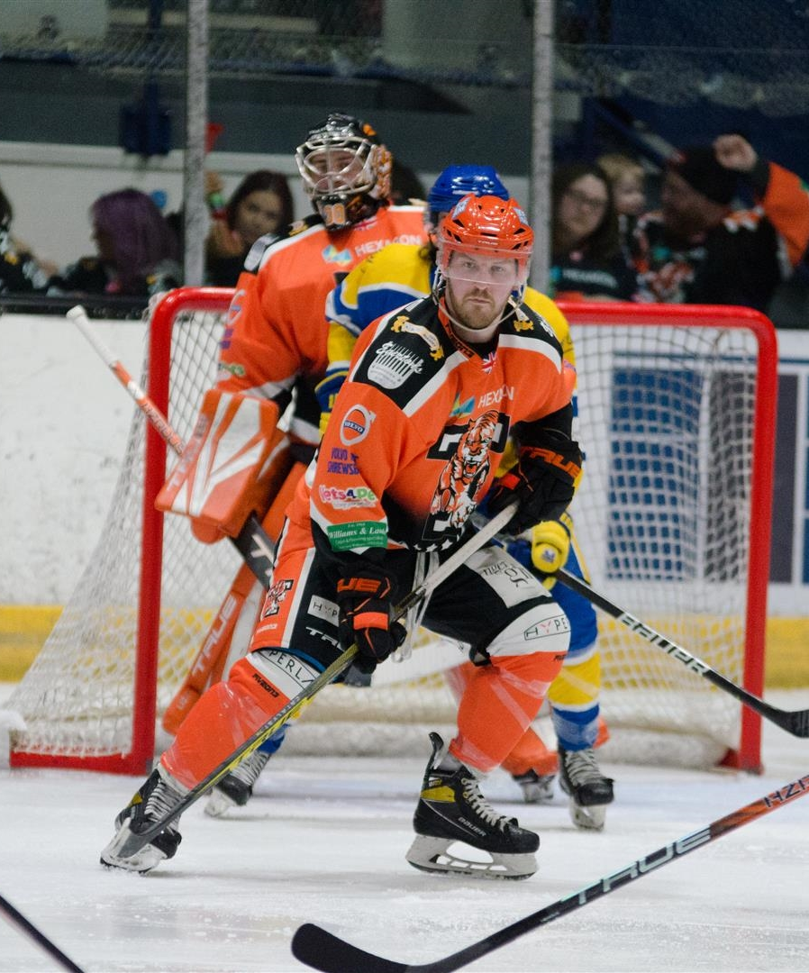
Where do you want your club to be?
You may want to break down the vision of your club into a short, medium and long-term. The vision(s) can then be broken down into aims that describe what you want to do and how your club will develop. Much of the information gathered to establish your club’s position in the ‘where are we now section’ will assist you in setting your aims for what you want to achieve. Refer back to the SMART principles when developing this section as this will ensure a clear target for achievement.
Use our club development template to think about where you are now, where you’d like to be, and how you might achieve this.
Remember, if you’re at capacity, you might need to think ‘outside of the box’ as to how you might provide more opportunities to grow, or you might want to simply think about how you retain a strong membership and succession plan.
If you’re a new club, set realistic expectations and think about how you establish a strong core. Don’t try and grow too quickly; sustainability is key.

Slide 15
Marketing
Being able to promote your club and improving the communication within your club is crucial.
Marketing activity will help to attract new players, recruit additional volunteers or attract more people to your fundraising events. Internal communication is also important to highlight successes within the club or to make players and their friends and families aware of your activities and feel part of your club.
Use our club development template to think about how you might be able to market your club using different methods. We also have a template sponsorship document which you can adapt and use.

Slide 16
Funding
Getting funding can really help you financially, especially with the high costs involved in ice hockey.
We have developed a funding guide available on our website to help you get started, but funding opportunities frequently change, and local authorities may have different opportunities available.
Local sponsorship is another great opportunity to help fund things like kit, equipment, hardship funds etc. Do you have any parents that run local businesses? Do any local businesses reflect your aims and ethos? What can you offer? Visibility at games, training sessions, via social media, holding activities / social events at their venue, giving back e.g. volunteer days.
Good governance and a strong ethos and vision will help you attract funders and sponsors. They need to know their money will be used ethically and managed well.

Slide 17
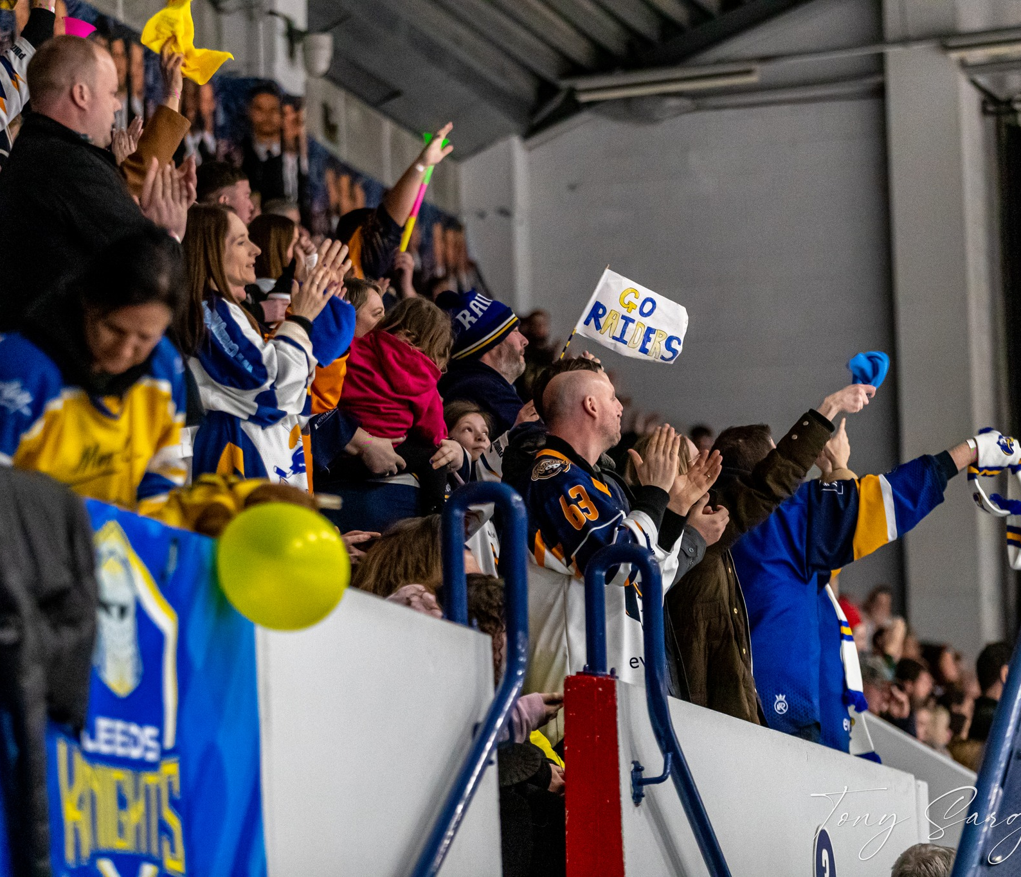
Welcome!
We are delighted that you are starting your club journey with us. Ice hockey is a fantastic community that gets people involved in the fastest indoor sport in the world!
Support for clubs
The England Ice Hockey staff and volunteers are here to offer support and guidance to help you build a successful club. Please don’t hesitate to reach out to us for help.

Slide 18
OUR
PASSION
IS YOUR OPPORTUNITY

Slide 19
England Ice Hockey
iceSheffield, Coleridge Road, Sheffield, S9 5DA
info@englandicehockey.com
englandicehockey.com

